Slide 1
Smart Mirror
Team MyrR

Slide 2
Why Choose a Smart Mirror
Convenient day-to-day use
Day planner/calendar
Weather forecast
Voice Recognition
Music Player with speaker system
Easy smart phone connection via Bluetooth
Development cost is approx. $400.

Slide 3
Smart Mirror’s Components
Smart Mirror consists of:
Raspberry Pi 3 B+
phone application
LCD screen
dielectric glass material
LED lights
speakers
USB sound card and microphone
wooden casing for the mirror

Slide 4
Qualitative Goals for Smart Mirror
Enough memory to hold all apps (10GB storage)
Access speed and scheduling of applications (<1s)
Speakers have a sensitivity of 80 decibels/2.83 volts
Dielectric glass is at most 30% transparent
Voice input has at least 90% accuracy
User’s phone is able to connect to the mirror in range of 50 ft

Slide 5
Software Design Approach
Enable Windows IoT, Linux, or Windows OS for Raspberry Pi
Import Google Music, Google Calendar, clock widget, and Memos for Raspberry Pi
Setup local server to store voice commands (SQL server)
Enable Google Assistant or Voice Dictation software to process voice input
Use Angular or PHP to create phone application

Slide 6
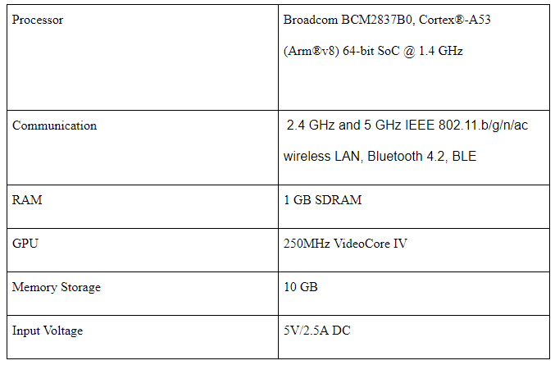
Hardware Elements
Raspberry Pi 3B+

Slide 7
Mirror Enclosure
LCD Screen

Slide 8
Speaker
Speaker Amplifier

Slide 9
Dielectric Mirror
LEDs

Slide 10
Plan for Smart Mirror Power
120v AC to 5v DC for Raspberry Pi
Potential 120v AC to 12v DC for LEDs
Battery Backup for 5V Raspberry Pi, 12V LEDS/Speaker Amplifier circuit
Keep wiring within the shadow box of mirror enclosure

Slide 11
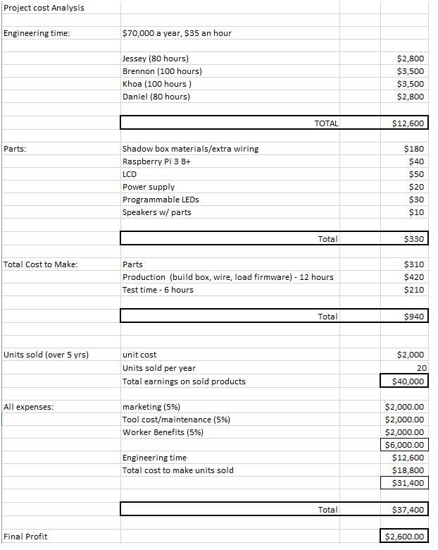
Cost Analysis
Hardware totaling $330
At 20 units per year, $2000 per unit, a profit of $2,600 would be made after all necessary costs.

Slide 12
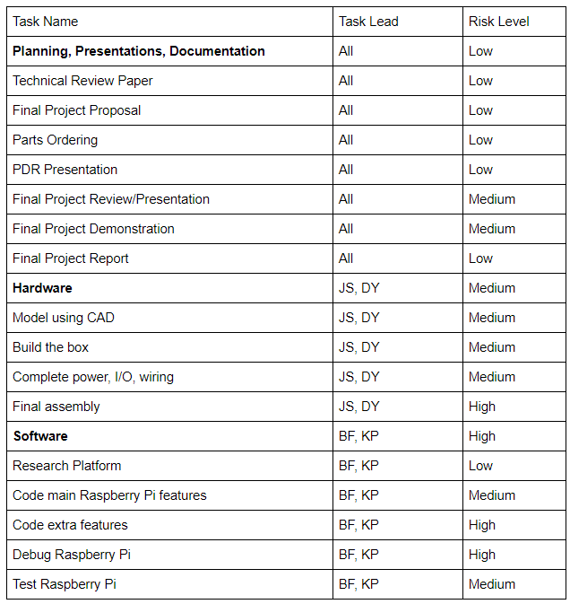
Risk Assessment and Concerns
Hardware is relatively straightforward with concern on the battery backup aspect
Software concerns lie on creating OS/application and debugging
Voice Recognition is a strong concern currently (lack of team help)
Final assembly and testing are both very high concerns because of potential unforeseen setbacks

Slide 13
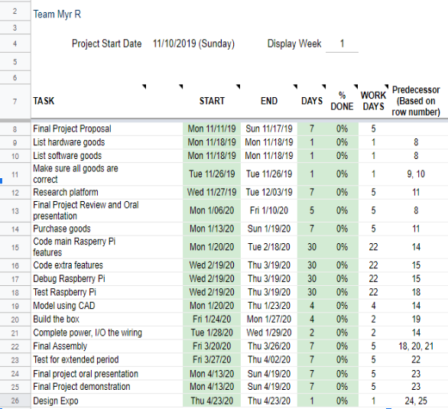
Project Schedule

Slide 14
Project Status
Currently, the Oral Presentation today is the last step before ordering parts and beginning the software programming.
The building of the enclosure and wiring will be done simultaneously with the software. We plan on everything coming together for the final assembly, debugging and testing.
The main concern for progress moving forward is the unexpected lack of “manpower” going onward. We are in close contact with Dr. Frazier about that.

